Slide 1
Virtual IT Partner
TOOLS

Slide 2
Toolset Overview
Provides a unified approach to the most common and needed management tools needed in IT
Saves money by consolidating tools into a monthly expense
Unifies access to status and action via single web portal
Provides critical security and security management features
Allows for detailed auditing and reporting across the products
Can alert on critical issues automatically, via ticket and through personal notifications
Eliminates managing software updates and renewal contracts

Slide 3
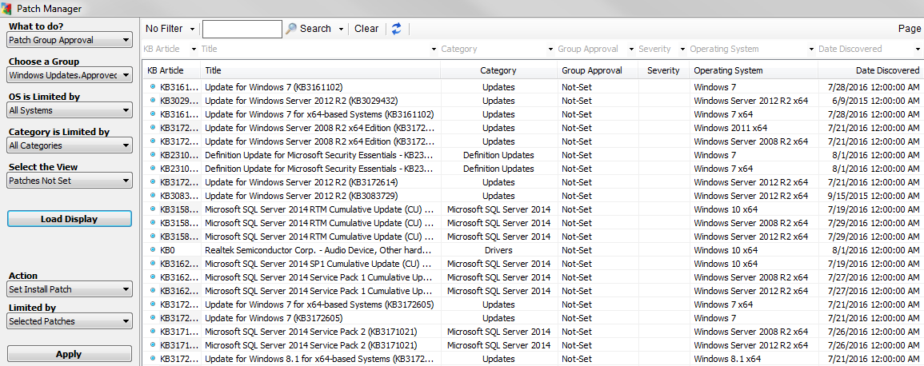
Patch Management
Dashboard at a Glance
Patch Management
Patch Deployment
Scripted Reboots
Patch Whitelisting Service
Service Pack Installations

Slide 4
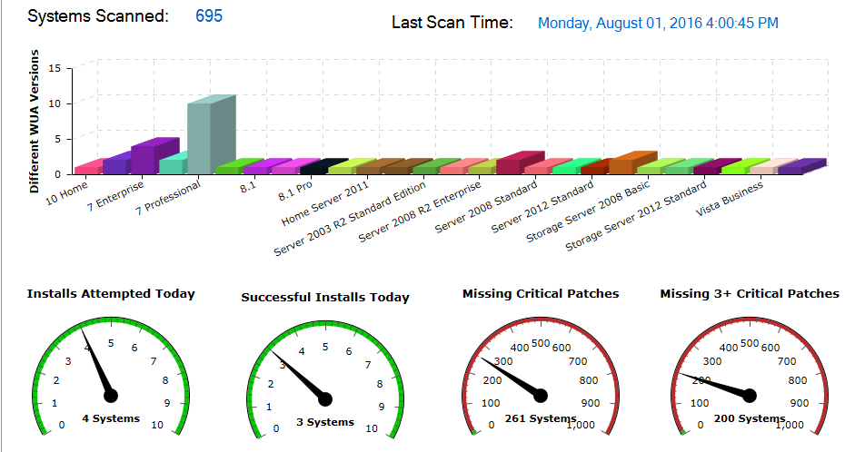
Management Portal
- Web-based Management Portal
Hardware and Software Audits
Desktop Performance Monitoring
Administrative Scripting
Policy Management
Client Communicator
Critical Alerts Notification
Backup Job Monitoring
SNMP Monitored Device Status
VMware Monitoring
Patch Status
Reporting Portal

Slide 5
End User Communicator
End User Communicator
Hardware and Software Audits
Desktop Performance Monitoring
Administrative Scripting
Policy Management
Client Communicator

Slide 6
Customizable Reporting
Many reports to choose from
Hardware Summary
Software by PC / Application / Vendor
Performance & Application Monitoring
Technical System Information
Disk Space, App list, Installed Software
System Information (mem, cpu, mfg, bios)
Audit Reports
Remote Control
Logins
Alert Configurations
Patch Update Report
Third Party Patch Report
Preventative Maintenance Reports
Anti-Virus / Anti-Malware
Malware Scan Reports
Status and Version reports
VMware Executive Report
All Exportable to Excel

Slide 7
Anti-Malware
Built to protect your business when most traditional endpoint solutions can't
Malwarebytes business products provide the strong anti-malware detection and remediation your business needs to survive in today's threatscape. Unique and powerful, Malwarebytes business products deliver the layered defense experts recommend.

Slide 8
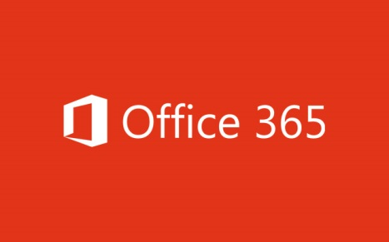
Hosted Email
Since 2001, Securence is the worldwide leader in hosted email
Advanced Spam Blocking
Email Cloning
Message Forwarding
Advanced Routing
Spam Quarantine
50 GB mailbox per user
One Note 1 TB file storage and sharing
Skype For Business HD video conferencing
Office Online

Slide 9
Data Backup
Efolder is a disk-to-disk recovery solution designed to provide fast, simple, reliable protection and recovery on both physical and virtual servers from local disk or off-premise cloud storage

Slide 10
3rd Party Patching
The App-Care patch management solution extends the power patch management capabilities beyond just Microsoft updates to third party applications such as Adobe Reader, Adobe Flash, Java Runtime and more. Unpatched applications are highly vulnerable to malware which costs IT service providers time and move to remove. Created to integrate with LabTech, App-Care downloads necessary updates for devices and can push patches to computers to close security gaps in third party applications. Take control to automate the process and schedule patch installation to occur on your terms.

Slide 11
Secondary Virus
HitmanPro is a second opinion scanner designed to rescue computers that have become infected with viruses, spyware, Trojans, rootkits and other threats.
HitmanPro works alongside your existing antivirus software to detect and remove zero-day and other malware designed to evade detection by traditional antivirus software. It combines cloud computing, multi-criteria heuristics and behavioral analysis to effectively reveal and bypass the deceptive techniques employed by modern malware.

Slide 12
CCleaner
Automatic Cleaning – CCleaner can be scheduled to clean and optimize across profiles automatically.
Endpoint Optimization – CCleaner cleans out unnecessary files to free up valuable hard drive space, clears old registries that lead to instability and erases cookies from endpoints to keep client data confidential and secure.
Stop Unnecessary Programs – CCleaner stops Windows from running unnecessary background programs during startup that slow down endpoints. The result is faster boot times for end-users.
Eliminate Disruptions – Endpoints are cleaned quickly so end-users never experience downtime

Slide 13
Anti-Virus
Secure the Endpoint
Symantec Antivirus License per agent
Antivirus for PCs and Macs
Low CPU and memory usage
Email security and anti-phishing
Firewall protection
Malicious website blocking

Slide 14
Optional Services
Monthly or Quarterly Assessments
External Vulnerability Scans
Intrusion Detection
Backup and Disaster Recovery
Backup Verifications
DR Recovery Tests

Slide 15
HERITAGE VIRTUAL IT PARTNER - TOOLS | Qty | Monthly Costs | Total
Labtech - monitoring, alerting, reporting, patching, remediation | 0 | $7.00 | $0.00
includes Assurance updates
Secuity Bundle | 0 | $5.50 | $0.00
Appcare, Hitman, Malware Bytes, CCeaner
3rd party patching, secondary virus, malware protection, disk cleaner
Virus | 0 | $3.00 | $0.00
Symantec Cloud
Backup | 0 | $25.00 | $0.00
efolder local backup
Backup | 0 | $1.00 | $0.00
efolder off-site remote (per GB)
Hosted Exchange with SPAM | 0 | $12.95 | $0.00
Securence
Office 365 - Essentials | 0 | $5.00 | $0.00
Sonicwall Analyzer Content Filter reporting | 0 | $349.00 | $0.00
Syslog Monitoring | 0 | $495.00 | $0.00
PC station (for Analyzer and SysLog - 1 dedicated PC for each app) | 0 | $499.00 | $0.00

